Slide 1
Christopher Columbus
Amanda, Morgen and Kamilla
Social studies 8
Mr. Lilly

Slide 2
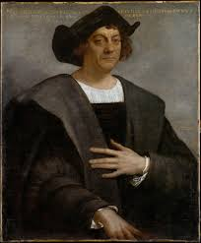
Introduction
-Christopher Columbus was a great navigator and organizer of expeditions.
-He sailed across the Atlantic ocean and got fame from it it.
-He brought diseases from place to place.
Notes:
Every ones heard of the poem but who really was Christopher Columbus? He was a great navigator and organizer of expeditions. He sailed across the Atlantic ocean and got fame from it it.
-He brought diseases from place to place.

Slide 3
Early life
Early life
-Born 1451
-He was the oldest of 5 children.
-Christopher formal education ended at about age 14.
Notes:
He was born 1451
-He was the oldest of 5 children.
-Christopher formal education ended at about age 14.

Slide 4
Political Background
-Struggling against the power of Ottoman Empire-conquered much of southeastern
Europe. (1451)
-Ottoman took control of constantinople, lots of trade between Europe and Asia
-Constantinople became the capital of there empire.
Notes:
Struggling against the power of Ottoman Empire-conquered much of southeastern
Europe. (1451)
-Ottoman took control of constantinople, lots of trade between Europe and Asia
-Constantinople became the capital of there empireStruggling against the power of Ottoman Empire-conquered much of southeastern
Europe. (1451)
-Ottoman took control of constantinople, lots of trade between Europe and Asia
-Constantinople became the capital of there empire

Slide 5
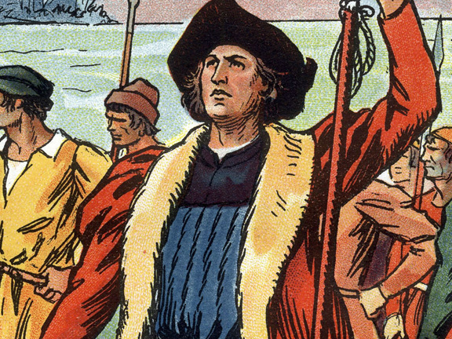
Career
-In his teenage years, he was pushed into working as an agent for commercial families.
Notes:
In his teenage years, he was pushed into working as an agent for commercial families, so for familys with trading businesses.

Slide 6
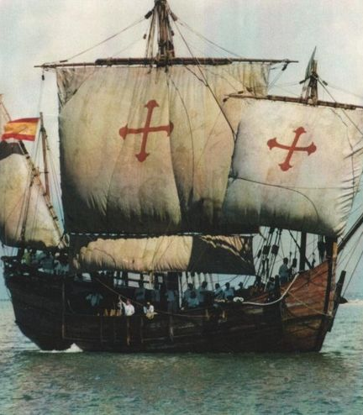
Voyeges
-First voyage was to southwestern Spain.
-He had 90 or more crew members on board.
-October 12. Before noon he landed the ships in the Caribbean sea. On a island called San Salvador. (Spanish for holy savior)
Notes:
First voyage was to southwestern Spain.
-He had 90 or more crew members on board.
-October 12. Before noon he landed the ships in the Caribbean sea. On a island called San Salvador. (Spanish for holy savior)

Slide 7
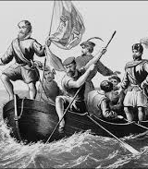
Greatest Achievements
First European to discover North America.
Between 1485, Columbus made several voyages to the canary island.
Columbus and his son went to Spain.
Notes:
First European to discover North America.
Between 1485, Columbus made several voyages to the canary island.
Columbus and his son went to Spain

Slide 8
Legacy
-Has been hailed as the “discoverer’’ of the new world.
-Columbus returned to Spain for the last time in 1504 and died two years later at the age of about 54.
-Went to sea as a teenager and went on to become a master navigator.
Notes:
-Has been hailed as the “discoverer’’ of the new world.
-Columbus returned to Spain for the last time in 1504 and died two years later at the age of about 54.
-Went to sea as a teenager and went on to become a master navigator.

Slide 9
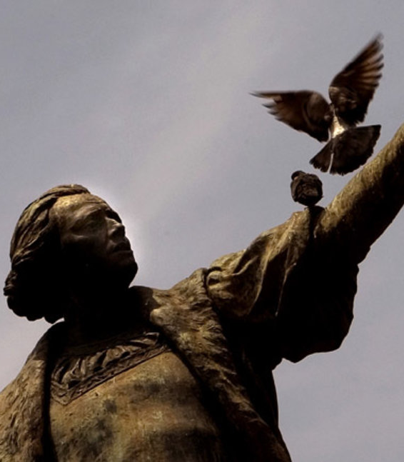
Crazy Facts
-Columbus made four voyages to the new world.
-Columbus returned to Spain in chains in 1500
-A lunar eclipse may have saved Columbus.
-Even in death, Columbus continued to cross the Atlantic.
Notes:
Columbus made four voyages to the new world.
-Columbus returned to Spain in chains in 1500
-A lunar eclipse may have saved Columbus.
-Even in death, Columbus continued to cross the Atlantic.

Slide 10
Conclusion
-He sailed into the ocean not knowing where he would land.
-He went off to America because he wanted to find gold, pearls and spices.
-He claims he found America.
Notes:
-He sailed into the ocean not knowing where he would land.
-He went off to America because he wanted to find gold, pearls and spices.
-He claims he found America.

Slide 11
References
http://www.worldbookonline.com/student/article?id=ar125200&st=christopher+columbus#tab=homepage
http://www.biographyonline.net/adventurers/christopher-columbus.html
http://www.littlesproutphotography.com/blog/category/san-diego-newborn-baby-photography/page/2/
http://kids.britannica.com/elementary/art-88703/The-four-voyages-of-Christopher-Columbus
http://www.bbc.com/news/world-us-canada-27397579
http://www.philart.net/person/Christopher_Columbus/16.html

