Slide 1
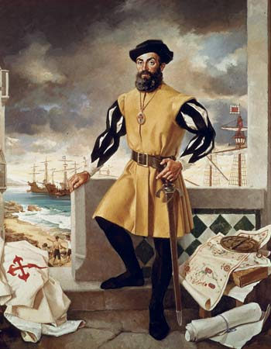
Ferdinand Magellan
Alex, Adora, Chanelle
Social Studies 8
Instructor: Mr. Lilly

Slide 2
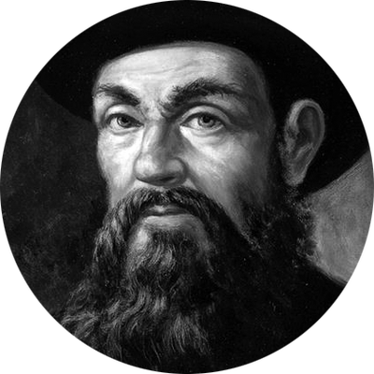
Introduction
Ferdinand Magellan was the man that proved the world was round.
This was when people thought the world was flat, so when Ferdinand went on his huge expedition, people thought he would fall of the world.

Slide 3
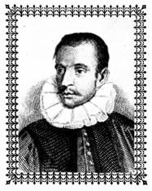
Early Life
He was born in Portugal around 1480.
He studied navigation at an early age.
He studied at Queen Leonor’s school of pages in Lisbon.
He was interested in cartography, astronomy and celestial navigation when he was younger.
His parents were members of the Portuguese nobility.
In 1505 Ferdinand traveled with the new Portuguese arriving to India, that's when he got the taste for sea travel. He also got the itch to explore.
He took part on February 2-3 1509 in the great Battle of Diu.

Slide 4
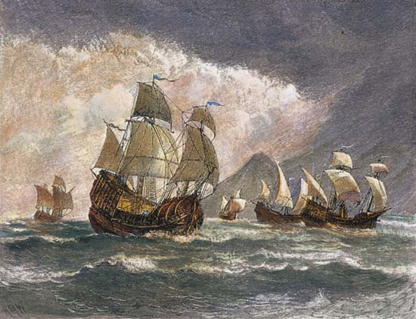
Career
Magellan served on ships in the Portuguese navy, until he was accused of theft.
Although he was proven innocent, his reputation was ruined amongst Portuguese sailors. Three times, Magellan petitioned the king of Portugal to support him on a voyage to search for a passage through South America to Asia.

Slide 5
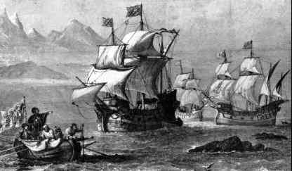
Voyages
In search of fame and fortune, Portuguese explorer Ferdinand Magellan 1480-1521 set out from In Spain in 1519 with a fleet of five ships to discover a western sea route to the Spice Islands.
In route he discovered what is now known as the Strait of Magellan and became the first European to cross the Pacific Ocean.

Slide 6
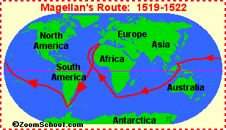
Portuguese explorer who led the first expedition to circumnavigate the globe.
Like many of his contemporaries, Magellan set out to discover a Western sea route to the Spice Islands in Indonesia.
Magellan ended up proving, instead, that the world was indeed round and bigger than anyone had previously imagined.
Greatest Achievement

Slide 7
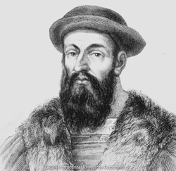
Legacy
In September 1519, Portuguese explorer Ferdinand Magellan set sail with a fleet of five Spanish ships in attempt to find the Spice Islands by heading west.
Although Magellan died during the journey, he is credited with the first circumnavigation of Earth.

Slide 8
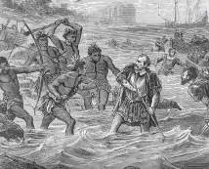
Crazy Facts
First man to travel all the way around the world.
That he proved that the world was round and much bigger than people thought
People use what he deserved to navigate.
That he died from a poison arrow

Slide 9
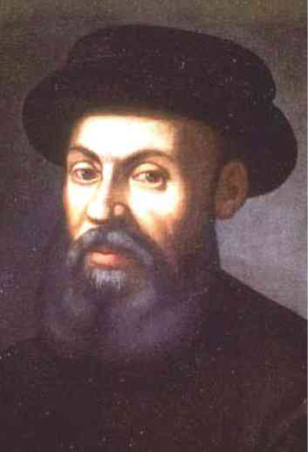
Conclusion
Ferdinand Magellan was a Portuguese explorer
First man to travel all the way around the world
He Discovered the Western sea route to the Spice islands

