Slide 1
Inferencing
Mini Lesson

Slide 2
Read this passage from the Marrow Thieves.
Answer the questions on the board in your binder.
Mitch was smiling so big his back teeth shone in the soft light of the solar-powered lamp we’d scavenged from someone’s shed. “Check it out.” He held a bag of Doritos between us—a big bag, too.
“Holy, Mitch! Where’d you get that?” I touched the air-pressurized bag to confirm it was real. My dirty fingers skittered across the shiny surface like skates. It was real. My mouth filled with spit, and a rotten hole in one of my molars yelled its displeasure.
French (in narration), p. 12 The Marrow Theives, Cherie Dimaline

Slide 3
How was Mitch feeling?
  How do you know?
How was French (the speaker) feeling?
  How do you know?
What is wrong with French’s mouth?
  How do you know?
What can we assume about these kids?
  Why can we assume this?

Slide 6
Inferencing
Good readers use their inferencing skills to construct a deeper understanding of the text.
Good writers use literary elements and skills to “show” a reader something rather than “telling” the reader something.

Slide 7
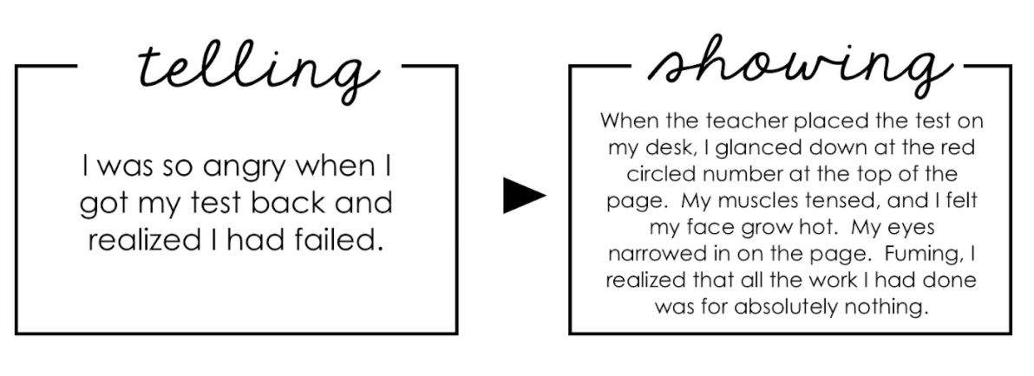

Slide 8

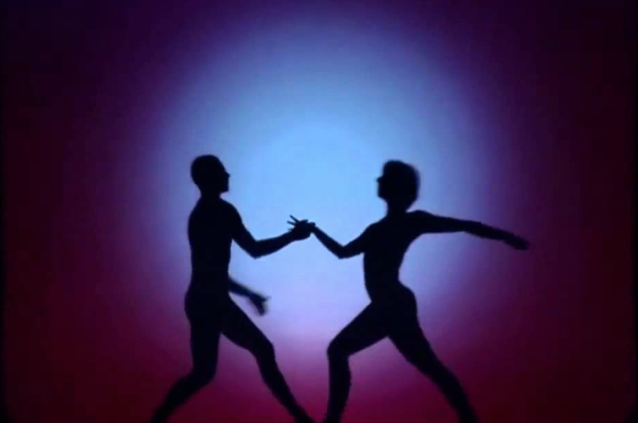
This Photo by Unknown Author is licensed under CC BY

